Slide 1

Welcome back!
Studio S3
Ma Chi Kin Brian
e1121386@u.nus.edu
Tele: @bmanara

Slide 2
How’s Week 2 of Uni?

Slide 3
Agenda for Today
Admin Matters
Recap
S3 Studio Worksheet
MORE RECURSIONS (In-Class Studio Worksheet)

Slide 4
Admin Matters
Forum Hours (From Week 3 Onwards)
Every Tuesday (6:30pm to 8:30pm) @ COM1 Basement
From now onwards, you will need to follow the style guide! (Missions & Quests)
Reading Assessment 1 (7 September 2024)
Look out for announcements for timing and venue!
Notes:
Show where the resources are

Slide 5
RECAP
Substitution Model
Recursion (Wishful Thinking…)
Orders of Growth
Notes:
Go to Source Academy!
Operands (5, 3 etc.) and Operators (+, -, / etc.)
Follows usual math conventions
Prints out “last line”
Our first way to use names to refer to computational objects, CONSTANTS!
We can refer to our constants once declared.
Our first layer of abstraction.
Function declarations, a much more powerful abstraction technique!
With this, a compound operation can be given a name and referred to as a unit.
‘function name(parameters) { return expression; }
name is a symbol associated with the function definition
Parameters are the names used within the body of the function to refer to corresponding arguments.
In the simplest form, the body of a function is a single return statement.
After declaring, we can use it in a function application expression. (calling the function)
‘predicate ? consequent : alternative’
Predicates evaluates to true or false.

Slide 6
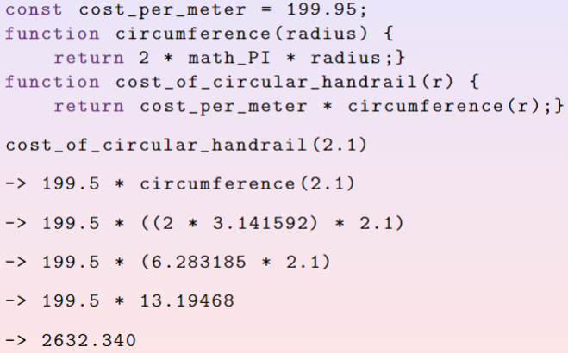
Recap: Substitution Model
Function Application

Slide 7
Recap: Substitution Model
Applicative Order Reduction
Normal Order Reduction
Notes:
Applicative Order Reduction - resolve the arguments first, before expanding
Normal Order Reduction - Delay argument evaluation to the end, evaluate once there is nothing left to expand

Slide 8
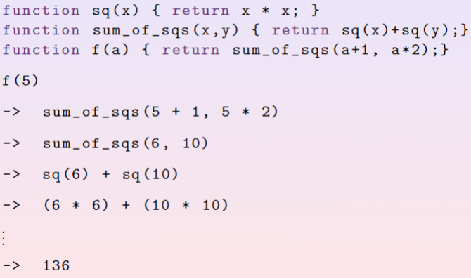
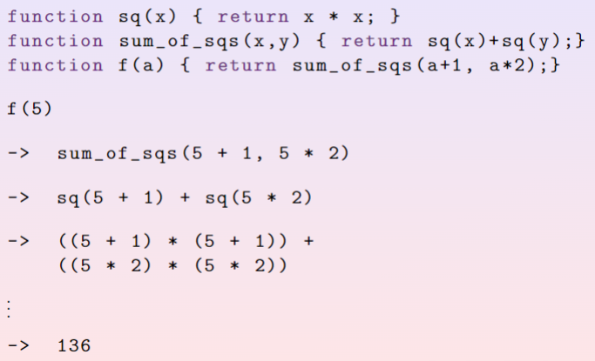
Recap: Substitution Model
Applicative Order Reduction
Resolve the arguments first
Normal Order Reduction
Delay argument evaluation till the end
Only evaluate when there is nothing else to ‘expand’

Slide 9
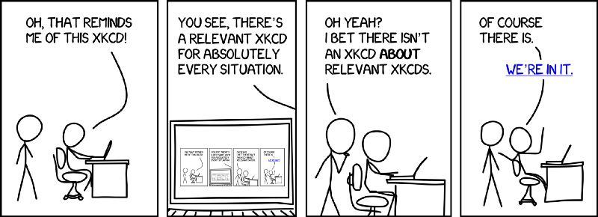
Recap: Recursion
What’s the recipe for recursion?
Notes:
Base Case, Recurrence Relation, Wishful Thinking

Slide 10
Recap: Recursion
Recipe for recursion:
Base Case:
Some condition or scenario that causes the function to STOP calling itself
Returns a result that doesn’t lead to further recursion
Simplest case that returns the correct output
Recurrence Relation:
Recursively defines the NEXT term
Function calls itself here
Wishful Thinking?
Essentially, we “wish”/assume that the result of the next recursive call will give us the correct answer.
Notes:
Give example using factorial function?

Slide 11
Recap: Recursion
Recursive Process
Write the fibonacci() function with a recursive process
Iterative Process
Write the fibonacci() function with a iterative process
What’s the difference between the 2 processes?
Notes:
Draw the recursion tree for both!
Once done, show stepper tool!

Slide 12
Recap: Recursion
Recursive Process
Write the fibonacci() function with a recursive process
Iterative Process
Write the fibonacci() function with a iterative process
What’s the difference between the 2 processes?
The Number of Deferred Operations!

Slide 13
Recap: Orders of Growth
We are concerned about Time & Space… What does that mean?
Time: Time taken to run the program
Space: Memory used to run the program
Recall the factorial function shown in lecture.
-> factorial(5)
-> 5 * factorial(4)
…
Number of deferred operations grows …
Notes:
Remind the students that for now, this is not so important to try and understand.

Slide 14
Recap: Orders of Growth
We are concerned about Time & Space… What does that mean?
Time: Time taken to run the program
Space: Memory used to run the program
Recall the factorial function shown in lecture.
-> factorial(5)
-> 5 * factorial(4)
…
Number of deferred operations grows linearly!

Slide 15
Recap: Orders of Growth
Notations:
Big O (Upper Bound)
Big Theta (Tight Bound)
Big Omega (Lower Bound)
Interested in the rough measure of resources used with respect to problem size.
Notes:
Again. Not so important to understand, I don’t mind explaining at the end of the studio but not during…

Slide 16
Recap: Orders of Growth
Exercises:
O(n² + n + 4) = ?
O(2n + e) = ?
O(2^{2n}) = ?

Slide 17
Recap: Orders of Growth
Exercises:
O(n² + n + 4) = O(n²)
O(2n + e) = O(n)
O(2^{2n}) = O(2^{2n})

Slide 18
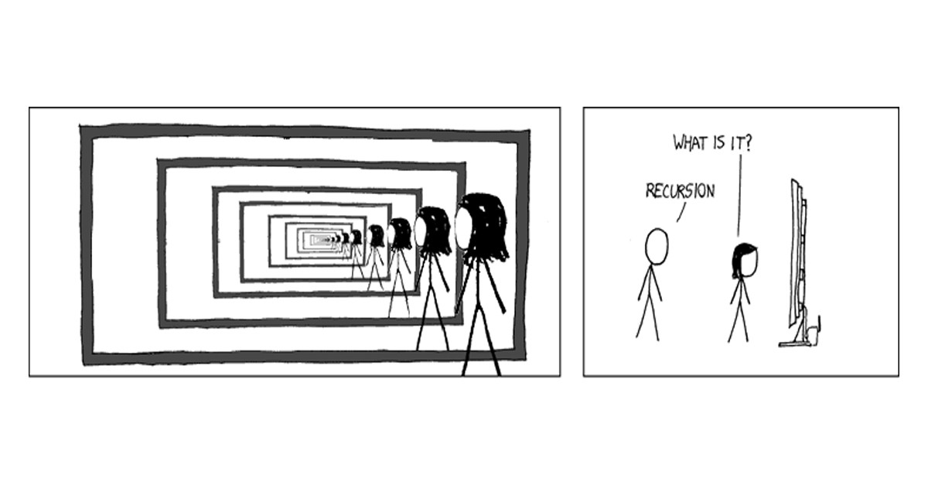
Recursion;
Iterative and Recursive Processes
(S3 Studio Worksheet)

Slide 19

Solution to Q1:

Slide 20

Solution to Q2:

Slide 21
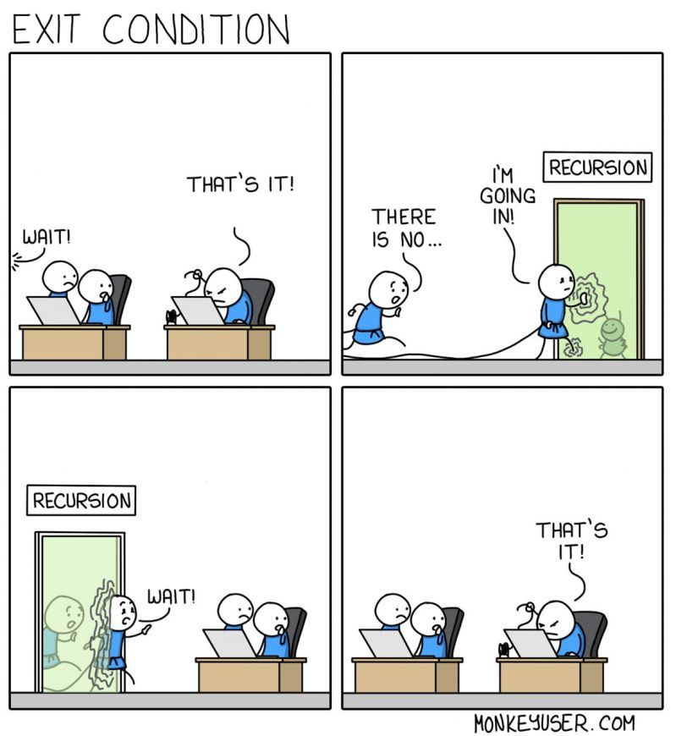
MORE RECURSION
(S3 Studio In-class worksheet)
Notes:
Go through the first 3 questions, then split them up into pairs and let them do and present their solutions

Slide 22
See you next week!
Slides will be uploaded to the google drive.
Notes:
Get NUSNETID and full name from students

